Slide 2
Supervised learning (X -> y)
Supervised learning is core building block for developing LLM, large language model. Repeatedly predict next word
Ex. My favourite food id beagle with cream cheese and lox
Input x | output
My favourite food is | bagle
My favourite food is bagle | with
My favourite food is bagel with | cream
My favourite food is bagel with cream | cheese

Slide 3
Two types of LLM
Base LLM
Predict next word based on training data, it takes month
Instruction tuned LLM
Train base LLM on big data, after this further train model fine tune it on small input set where output follow it, from base LLM to instruction tuned LLM cone quickly

Slide 5
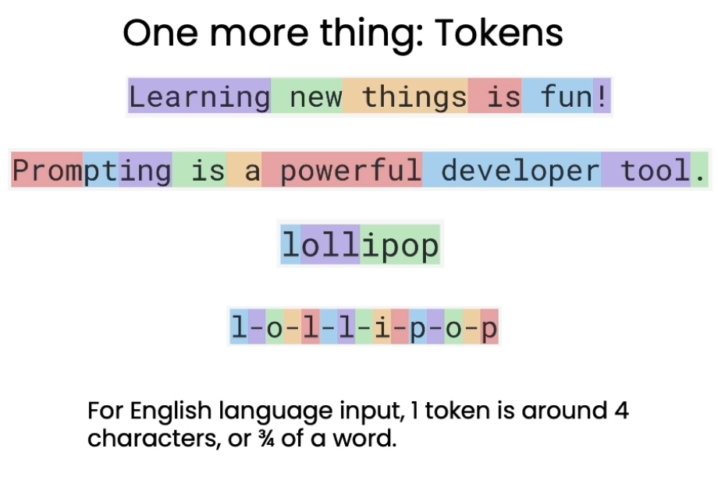

Slide 6
input
Input: 4000 token

Slide 7
System: set tone/behaviour of assistant
Assistant: LLM Response
User: prompt

Slide 8
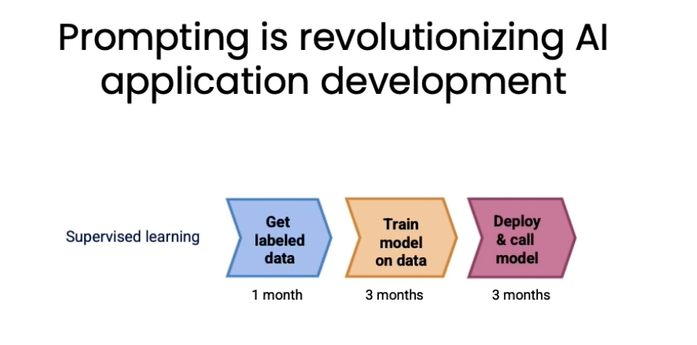

Slide 9
